Slide 1


\
Request for Proposals is Open
TCU Building Bridges Grant Program
A Science, Technology, Engineering & Math (STEM) grant-funding opportunity developed in partnership with the American Indian Higher Education Consortium (AIHEC) and the National Aeronautics and Space Administration (NASA)
Workshop:
Budget Development

Slide 2


Today’s Agenda
Welcome
Budget Development
Budget Guidelines and Funding Restrictions
Scoring Rubric
Review
Discussion and Questions
Closing & Next Steps

Slide 3

Timeline
& Overview
\
Each cycle, 4 webinars will be offered to support the proposal development process.
Information Session + Q & A (September 26)
Workshop: Community of Practice (October 4)
Workshop: Building A Competitive Proposal (October 11)
Workshop: Budget Development (October 18)
Office Hours: Monday, TBD
*Webinars will also be recorded and uploaded to AIHEC.org for review
TCU faculty and staff who are interested but are not ready to submit a project are encouraged to attend workshops and learn more about the program, then submit an application for a future cycle.
Notes:
In today’s Workshop, we’ll be discussing the Narrative piece of the proposal – our next Workshop will cover Budget and Budget Narrative development.
Note: 8/6 will be our final Workshop - ‘Office Hours’. This will be an opportunity for you to come in and ask any last-minute questions you may have. This is scheduled 1 week before submission date of 8/12.

Slide 4
RFP Overview - FAQ
RFP RELEASE DATE: September 16, 2024
PROPOSAL DUE DATE: 11:59 PM Eastern Time (ET) November 12, 2024
FUNDING AMOUNT: Multiple awards of up to $68,600 are available
ELIGIBILITY: Funds are available to faculty led teams from all accredited Tribal Colleges & Universities
ESTIMATED CONTRACT PERIOD: January 16, 2025, through January 15, 2027, or up to 2 years (24 months) from date of award, depending on the scope of the project. Projects designed for shorter periods of time will receive equal consideration. If projects last 1 year or less, projects can be renewed for a second cycle with an additional award.
Notes:
Review this.

Slide 5
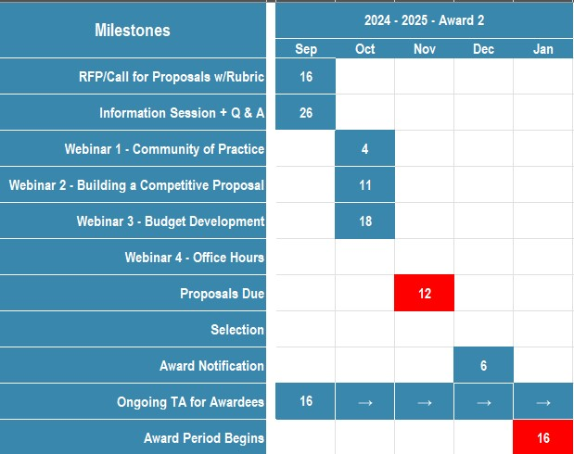
Timeline
& Overview
\

Slide 6
Review
\
Project Goals
Project must meet at least two of the three programmatic goals
1. Increase the number of Tribal College students engaging in STEM research and education activities. (Examples: internships, externships, Experiential Learning Opportunities (ELOs), Research Experiences for Undergraduates (REUs))
2. Increase the enrollment of Tribal College students in STEM degree programs and pursuing STEM career pathways.
3. Strengthen the capacity of the Tribal College to deliver STEM courses, degrees and curriculum.
AND
Demonstrate alignment to at least one of the three strategic goals
1. Strategic Goal 1.0: Create unique opportunities for a diverse set of students to contribute to NASA’s work in exploration and discovery.
2. Strategic Goal 2.0: Build a diverse future STEM workforce by engaging students in authentic learning experiences with NASA’s people, content and facilities.
3. Strategic Goal 3.0: Attract diverse groups of students to STEM through learning opportunities that spark interest and provide connections to NASA’s mission and work.
Notes:
Proposal Goals are in keeping with the overarching goal of the TCU Building Bridges Grant program to enhance the ability of TCUs to provide high quality STEM education programs, participate in collaborative STEM research initiatives, and ensure the inclusion of American Indians and Alaskan Natives in a well-prepared NASA STEM workforce.

Slide 7

Budget
Budget Guidelines and Funding Restrictions
Funding for the Principal Investigator’s (PI) salary must not exceed 15% of the proposer’s total budget.
A maximum of 20 percent of the total budget may be used for infrastructure (equipment and laboratory facilities).
A maximum of 15 percent of the total budget may be used for acquiring direct NASA services related to the conduct of research (i.e., cost for use of NASA unique facilities, etc.).
A maximum of five (5) percent of the total budget may be distributed to NASA Centers that are partnering with institutions. These funds may not be used for NASA civil servant salaries or travel.
The lead TCU shall retain and utilize 100 percent of the total budget. No subawards will be allowable under these grants.
\

Slide 8

Budget
Table
  Budget Table
  NASA Bridges funds may be used for the support of:
        TCU students (stipends), faculty, and staff (salary & fringe)
        Subject matter expert consultants
        Research-related equipment, travel, and materials
        Professional development program registrations and associated travel costs
        Overhead/general and administrative (G&A) rate (include negotiated rate agreement)
        NASA and AIHEC will provide a sample budget template. Points will not be lost for using an in-house template but must be clear and concise.
        Include a brief description if necessary, and the anticipated total cost of the item or service. For staff and personnel time, include both the total amount as well as a per diem or hourly rate.
\
Notes:
Before writing your proposal….please read the RFP – NASA is very specific in what they want to see in a proposal and lays out their requirements very clearly.

Slide 9
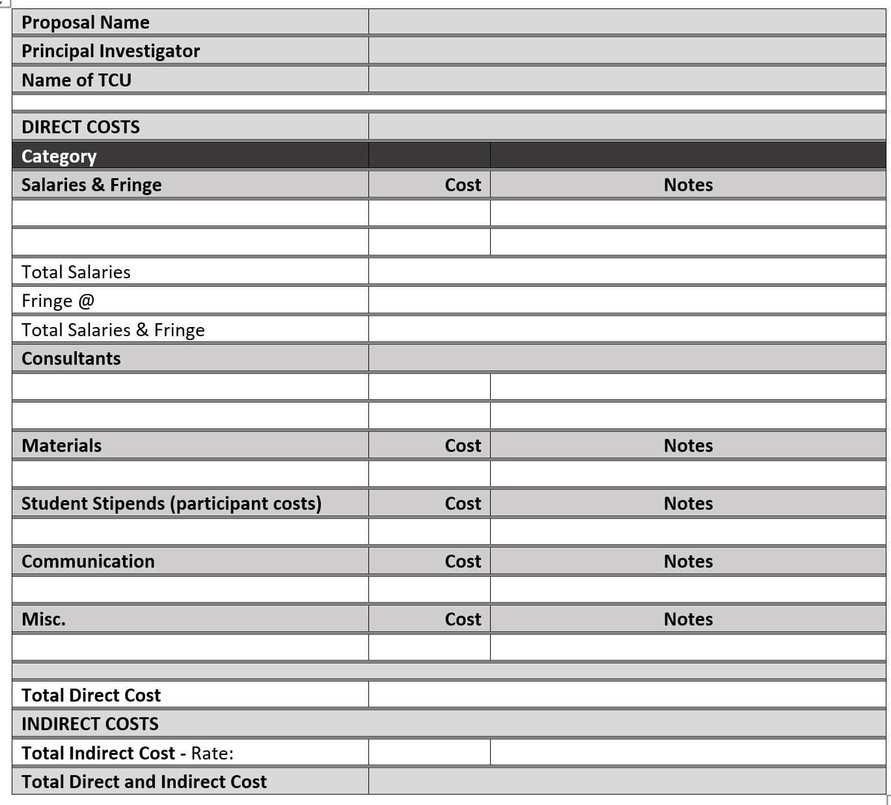

Budget Template
Provide a breakdown of the funds requested. Itemize big-ticket items, or major categories of materials or supplies to be acquired to justify how the funds requested will support the facilitation of your project. Group smaller items, example: craft supplies, tuning forks, etc. - Expand or change the table as needed.
\

Slide 10
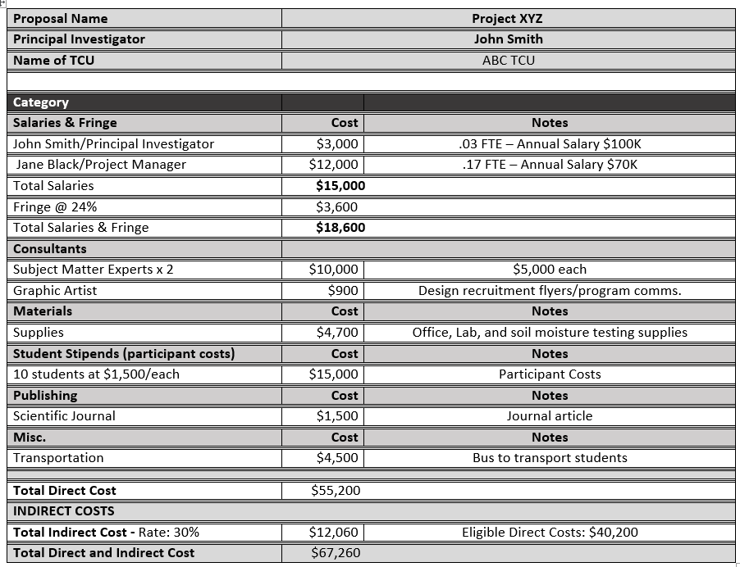

Slide 11
Budget
Table
Direct vs Indirect Costs
\
Direct costs
Direct costs are costs that are directly related to the project. Salaries, fringe benefits, materials and supplies, services, and travel are examples of direct costs.
Indirect costs
Indirect costs are costs that are not directly related to a specific cost, sometimes referred to as overhead (the cost of doing business) . Some examples of indirect costs include administration costs, utilities, building costs, etc.
Two Kinds of Indirect Cost Rates
Modified Total Direct Cost (MTDC) rate (negotiated rate) – Salary and fringe benefits, materials and supplies, services, travel
De Minimis indirect cost rate – 10% of MTDC

Slide 12
NASA Indirect Cost Guidelines
Indirect cost rates shall be calculated based on the proposing institution’s guidelines.
“Indirect costs including the lead institution’s general and administrative (G&A) expenses are permitted under this NOFO”.
Any indirect costs must comply with the “Indirect Costs” section of the *NASA Grant and Cooperative Agreement Manual (GCAM), currently section 5.14.2 and be consistent with the definition of “modified total direct costs” in **2 CFR 200.1, Definitions.
The budget must clearly include information for the lead institution’s overhead/ G&A expenses.
*Link to Document
**Modified Total Direct Cost (MTDC) means all direct salaries and wages, applicable fringe benefits, materials and supplies, services, travel, and up to the first $25,000 of each subaward (regardless of the period of performance of the subawards under the award).
\

Slide 13
Budget
Narrative
  Budget Narrative
Write a budget narrative that clearly describes anticipated expenditures and how they are necessary for the project. For each budget category, provide appropriate details taking care to be as specific as possible. Be sure to address any vague items such as ‘supplies’.
\
Notes:
Before writing your proposal….please read the RFP – NASA is very specific in what they want to see in a proposal and lays out their requirements very clearly.

Slide 14
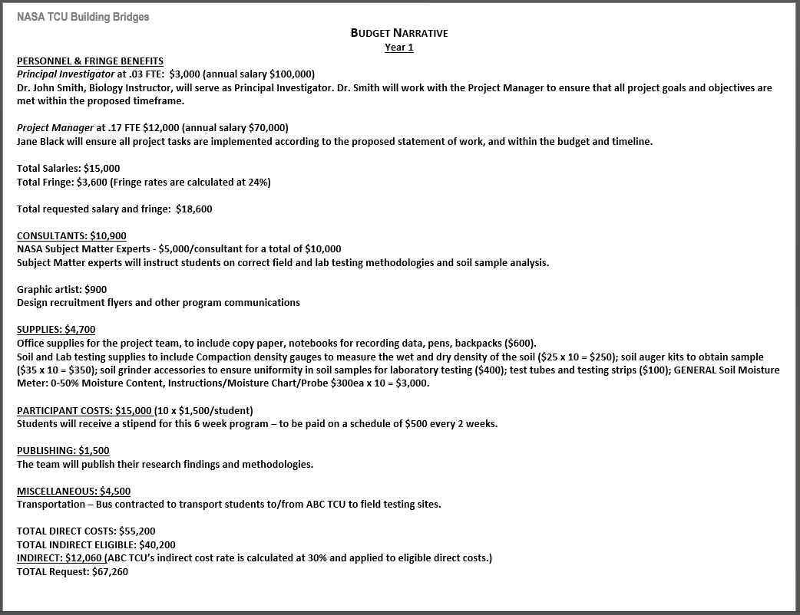

Slide 15


Checklist
CHECKLIST
BUDGET REQUIREMENTS AND RESTRICTIONS
\
Funding for the Principal Investigator’s (PI) salary must not exceed 15% of the proposer’s total budget. PI: $3,000 (Budget: $67,260)
A maximum of 20 percent of the total budget may be used for infrastructure (equipment/laboratory facilities). N/A
A maximum of 15 percent of the total budget may be used for acquiring direct NASA services related to the conduct of research (i.e., cost for use of NASA unique facilities, etc.). SME $10K
A maximum of five (5) percent of the total budget may be distributed to NASA Centers that are partnering with institutions. These funds may not be used for NASA civil servant salaries or travel. N/A
Address any vague items such as supplies. Included specific use/reason
The lead TCU shall retain and utilize of 100 percent of the total budget. No subawards will be allowable under these grants. No Subawards

Slide 16

REVIEW

Slide 17
Tips for Writing your Proposal
When writing your Proposal
Start Early – Finish Early – don’t wait until the last minute to start or finish, allow as much time as you can for developing/editing.
Time Crunch - If you’re struggling and/or find you’re running out of time – reach out to us – we’re here to help!
Thinking about post-award at the pre–award stage – Check in with faculty to insure they’ll have the bandwidth to execute the project as it’s designed in your proposal; Dean and Provost to ensure faculty release.
Pre-Application - Consider submitting a pre-application - this will help you flush out your idea(s) and give us the opportunity to provide feedback.
Keep in mind – this project doesn’t have to be a brand-new idea – rather, it can be designed to support an existing, ongoing (RFP qualified) faculty project.
\

Slide 18
Review
\
Priority Areas of Support
  Research experiences for undergraduates (REUs)
  STEM program instrumentation/equipment acquisitions
  Course and curriculum enhancements (new courses, delivery support technologies)
  Professional development for TCU faculty, undergraduate, and graduate students, including conferences and workshops
  In person, hybrid or virtual NASA Internships for TCU students which must be funded at the same level of set NASA Intern cost amounts, as shown in the tables
Notes:
If you’re trying to decide if your idea for a project aligns with the RFP, here are some things to consider. Or, if you know you want to improve the STEM program at your TCU and need an idea for a proposal, the Goals and Priority areas of support is a good place to start. Priority Areas of Support are in keeping with the overarching goal of the TCU Building Bridges Grant program to enhance the ability of TCUs to provide high quality STEM education programs, participate in collaborative STEM research initiatives, and ensure the inclusion of American Indians and Alaskan Natives in a well-prepared NASA STEM workforce.

Slide 19
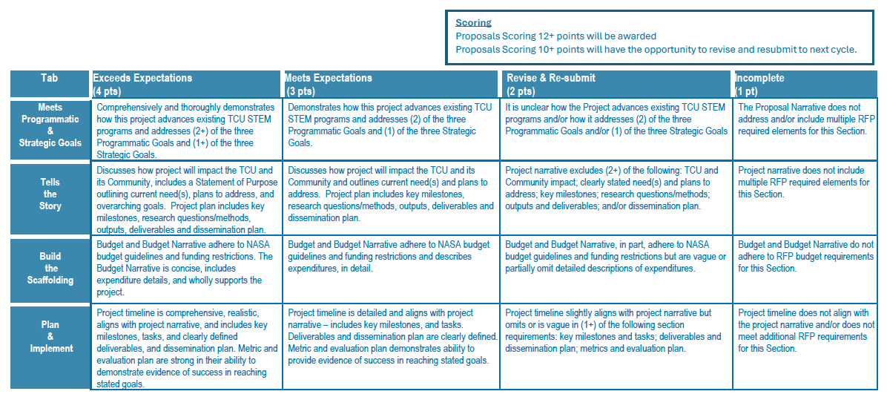
TCU Building Bridges
Scoring Rubric
\

Slide 20
Next
Workshop
Office Hours
We’re here to Help!
Tuesday, November 5th
3:00 – 4:00pm ET
\

Slide 21
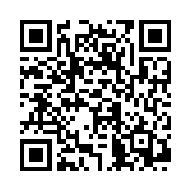
\
Thank you for coming!
Please complete our survey:
We will come back together
TBD
‘Office Hours’
Notes:
https://app.smartsheet.com/b/form/d7b1cc948a424d849d977da80b65758e

